Slide 1
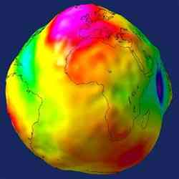
Coordinate Frames
ASEN 5090
ASEN 5090 LECTURE NOTES – LARSON, AXELRAD

Slide 2
Main Goals
What do people mean when they ask you what reference frame you are using?
Provide some of the background material you will need for this and later classes.
Define some jargon (not too much), but the biggies, like ECEF, ECI, and WGS84.

Slide 3
Outline
Coordinate Frames
Vectors and Transformation matrices
Earth Centered Inertial (ECI)
Earth Centered Earth Fixed (ECEF)
Transformation between ECI and ECEF
Latitude, Longitude, Height
Geoid height calculator

Slide 4
COORDINATE FRAMES
What defines a coordinate frame?

Slide 5
COORDINATE FRAMES
What defines a coordinate frame?
Defined by a center and three orthogonal unit vectors, i, j, and k. Use a right-handed set : i x j = k
Z
e.g. WGS-84
Y
X

Slide 6
WHAT DO COORDINATE FRAMES REALLY TELL YOU?
Z
Y
X

Slide 7
TRANSFORMATION MATRIX
The transformation matrix transforms the representation of a vector from one coordinate frame to another
Also called direction cosine matrix (DCM) - can be formed by dot products of unit vectors of two frames

Slide 8
TRANSFORMATION MATRIX PROPERTIES
Nine elements are not independent because it must be orthonormal

Slide 9
TRANSFORMATION MATRICES FOR EULER ROTATIONS
Rotation about 1st axis (e.g. X)
Rotation about 2nd axis (e.g. Y)

Slide 10
TRANSFORMATION MATRICES FOR EULER ROTATIONS
Rotation about 3rd axis (e.g. Z)

Slide 11
EULER 3-1-3 (boring, boring, boring)
First then then

Slide 12
EARTH CENTERED INERTIAL (ECI) AND EARTH CENTERED EARTH FIXED (ECEF)

Slide 13
EARTH CENTERED INERTIAL (ECI)
Origin at Earth center of mass
X – defined by direction of the vernal equinox (through the true equator)
Z – defined by axis of rotation of the Earth
Y – right-handed set (also through true equator)
Not exactly inertial because, origin accelerates as Earth travels around the sun, and the rotation axis precesses and nutates
The term ECI is a generic term for this system. New standards by the International Earth Rotation Service (IERS) outline a precise definition, officially calling this the Geocentric Celestial Reference Frame (GCRF)

Slide 14

ECI FRAME
^
Earth Rotation Axis
K
ECI
Equatorial Plane
^
^
I
J
ECI
ECI
Towards Vernal Equinox
Image Credit: Vallado, D.A., “Fundamentals of
Astrodynamics and Applications,” 3rd ed., 2007, pp. 159.

Slide 15
What do you think I mean by ECEF?

Slide 16
How do you get from ECI to ECEF?

Slide 17
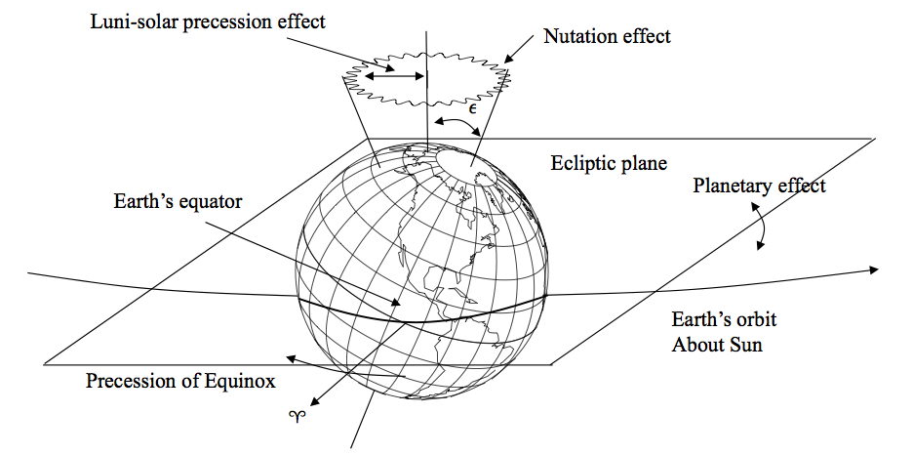
Precession/Nutation
Precession is ~23.5 deg cone and is caused by the gravitational attraction of the Sun and Moon on the non-spherical Earth (period 26,000 yrs)
Nutation is a small bobbing motion with period of 18.6 years (due to moon)
A spherical Earth with homogeneous density distribution would neither precess nor nutate
Image Credit: Vallado, D.A., “Fundamentals of
Astrodynamics and Applications,” 3rd ed., 2007, pp. 213.

Slide 18
EARTH CENTERED EARTH FIXED (ECEF)
Origin at earth center of mass
International Terrestrial Reference Frame (ITRF) is the new formal terminology
Z - axis through IRP – average position of rotation axis between 1900 and 1905 (north pole)
X - equatorial through a reference meridian (Greenwich meridian, 0° longitude)
Y - make it right-handed (90 degrees East of X)
18

Slide 19
EARTH CENTERED EARTH FIXED (ECEF)
Origin at earth center of mass
International Terrestrial Reference Frame (ITRF) is the new formal terminology
Z - axis through IRP – average position of rotation axis between 1900 and 1905 (north pole)
X - equatorial through a reference meridian (Greenwich meridian, 0° longitude)
Y - make it right-handed (90 degrees East of X)
Realization is based on a selection of a globally distributed set of points.
WGS 84 – World Geodetic System 1984 is one of these realizations
ITRF - International Terrestrial Reference Frame is a more accurate one
Offset between ECI and ECEF (simplified)
θ angle between vernal equinox and Greenwich meridian is Greenwich Apparent Sidereal Time, GAST (a simplification is to use Greenwich Mean Sidereal Time, GMST)
Polar motion
- the instantaneous axis of rotation moves around wrt the Earth’s crust (polar motion)
- x_{p}, y_{p}, represent the offset of the instantaneous axis of rotation (the Celestial Intermediate Pole) from the International Reference Pole (a fixed point on the Earth surface that serves as Z, aka the north pole)
19

Slide 20
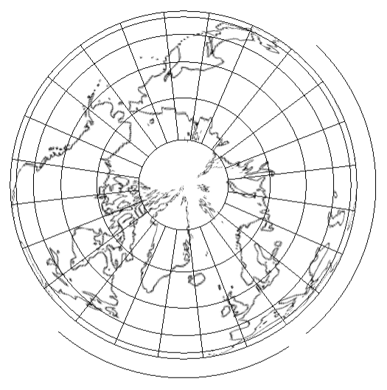
ECI-ECEF ILLUSTRATION
Local Observer
(longitude)
0°
^
^
I
I
ECI
ECEF

Slide 21
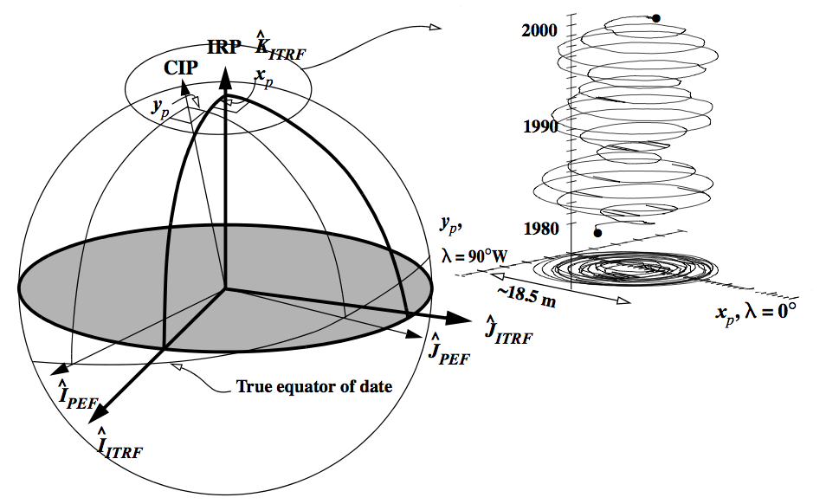
Polar Motion
CIP: Celestial Intermediate Pole (instantaneous rotation axis of the Earth)
IRP: International Reference Pole (agreed upon “north pole” of Earth for ITRF)
x_{p},y_{p}: polar motion coordinates
Polar motion cannot be predicted. x_{p} and y_{p} are observed parameters
Similar image in Misra and Enge Ch 4
Image Credit: Vallado, D.A., “Fundamentals of
Astrodynamics and Applications,” 3rd ed., 2007, pp. 216.

Slide 22
Take Home Message – you need to measure or model all of these motions if you want to accurately determine position using GPS.
Similar image in Misra and Enge Ch 4

Slide 23
TRANSFORMATION BETWEEN ECEF-ECI
Full Precise Transformation
Precession
Nutation
Polar Motion
Sidereal-Rotation
Simplified Transformation
Use rotation about z-axis through Greenwich Mean Sidereal Time (GMST) only
Accurate to about 100 meters in LEO and 1 km at GEO
23

Slide 24
The good news
You can treat almost everything in this powerpoint as useful information, but you do not need to understand it very deeply!
The professionals – i.e. the people that compute orbits for you (that would be the Department of Defense for navigation users of GPS and geodesists for the advanced GPS class) give you everything in ECEF.
You will not personally be asked to do the ECI-ECEF transformation.

Slide 25
LATITUDE, LONGITUDE, HEIGHT

Slide 26
LATITUDE, LONGITUDE, HEIGHT
Angular coordinates are convenient/intuitive Requires a smooth model for the earth
Geocentric latitude goes through the center of the ellipse
Shape of the Earth is approximately an ellipsoid – fatter at the equator, flattened at the poles.
Parallels (latitudes) are circles. Meridians (longitudes) are ellipses.

Slide 27
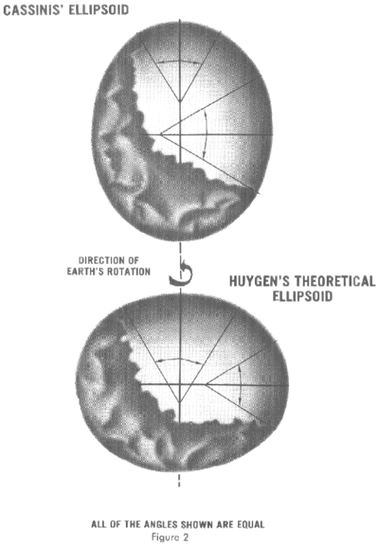
If the Earth is an egg, which kind of an egg is it?

Slide 28
How do you think historical geodesists measured the ellipsoid?

Slide 29
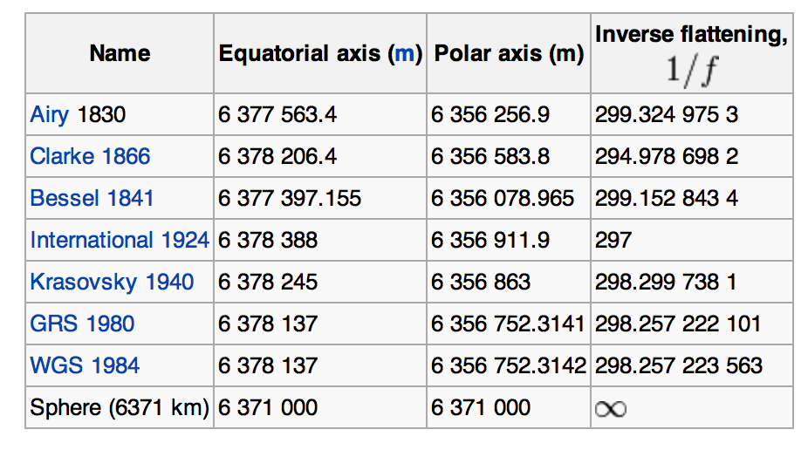
Parameters to define the ellipsoid
French expeditions, 1735-1750, 1/f = 210.

Slide 30
LATITUDE, LONGITUDE, HEIGHT
Angular coordinates are convenient/intuitive Requires a smooth model for the earth
Geocentric latitude goes through the center of the ellipse
Shape of the Earth is approximately an ellipsoid – fatter at the equator, flattened at the poles.
Parallels (latitudes) are circles. Meridians (longitudes) are ellipses.
Geodetic coordinates are referenced to this ellipsoid:
Geodetic latitude - angle between the equatorial plane and a normal to the ellipsoid surface at P.
Geodetic longitude angle between meridian and reference
Geodetic or ellipsoidal height is distance along a line normal to the ellipsoid at P (Figure 4.4)
The ellipsoid is just a mathematical figure or reference surface.
Countries/Regions pick an ellipsoid that suits them - so the “height” wrt these local reference frames can change at international boundaries.

Slide 31
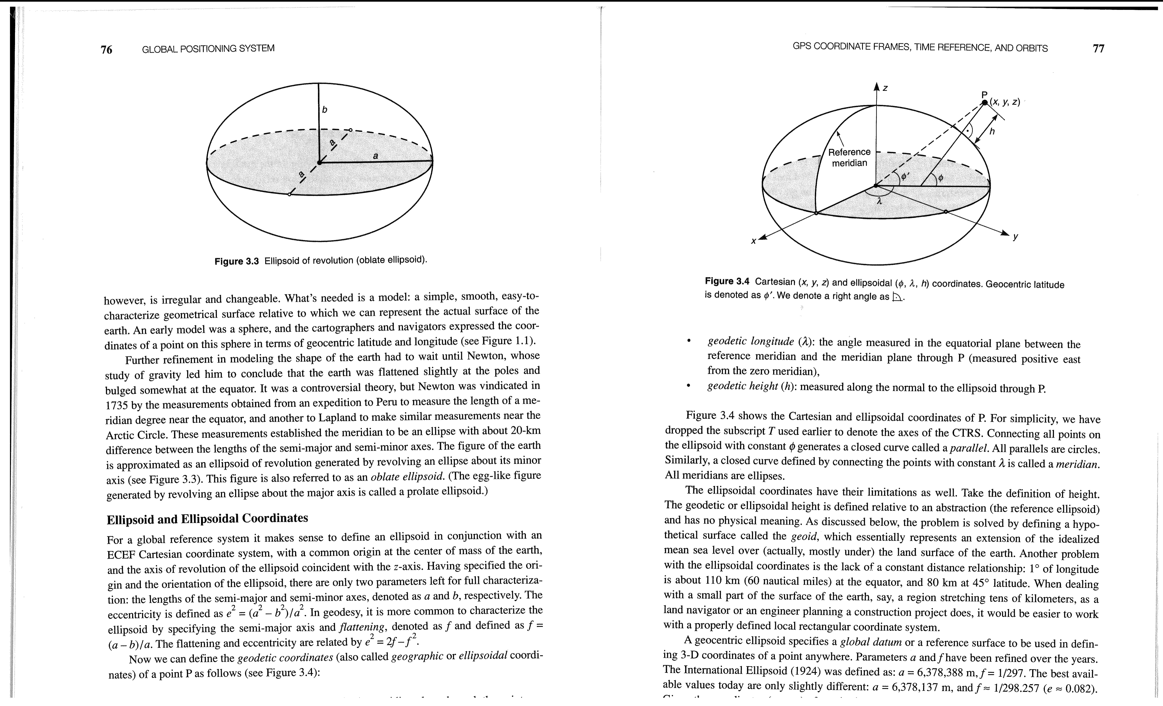
GEODETIC LAT/LON/ELLIPSOID HEIGHT to ECEF
0°
WGS-84 Ellipsoid Parameters
(Semi-major axis of ellipsoid)
(flattening parameter of ellipsoid)
(square of eccentricity of ellipsoid)
Image from Misra and Enge Ch 4
Note: is known as the radius of curvature in the meridian

Slide 32
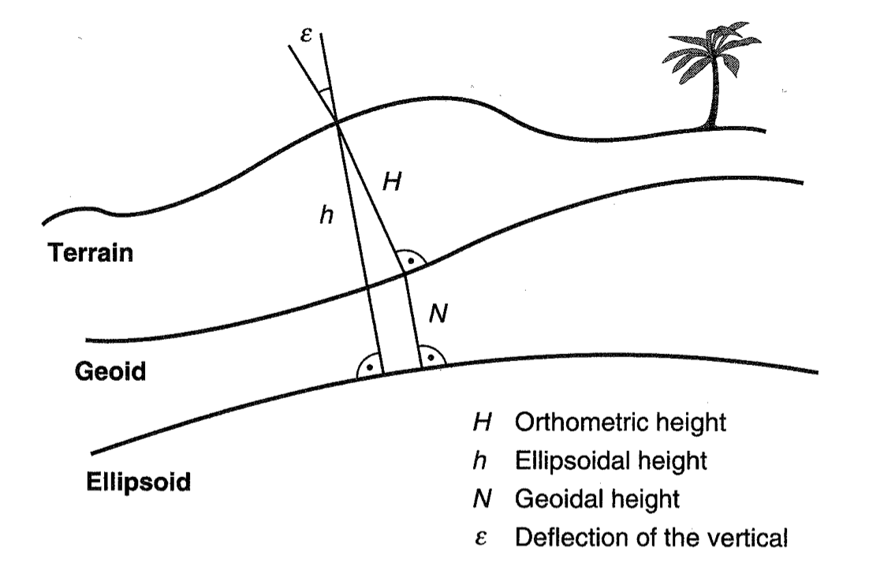
HEIGHTS
Ellipsoidal Height: height of object wrt reference ellipsoid (e.g. WGS-84 ellipsoid, used by GPS)
Orthometric Height: height of object wrt reference geoid (e.g. WGS-84 geoid or EGM-96 geoid)
- orthometric height is commonly known as height above mean sea level
Image Credit: Misra and Enge Ch 4

Slide 33
ECEF to GEODETIC LAT/LON/ELLIPSOID HEIGHT
Image from Misra and Enge Ch 4
Algorithm from Vallado, D.A., “Fundamentals of
Astrodynamics and Applications,” 3rd ed., 2007, pp. 179.

Slide 34
GEOID
The GEOID is a surface where gravity is constant (aka Mean Sea Level)
Examples: WGS-84 geoid, EGM-96 geoid (also wrt WGS-84 ellipsoid)
Includes: ECEF Cartesian frame, ellipsoid of revolution, gravity and geoid, and constants:
Semi-major axis (a)
Reciprocal flattening (1/f)
Rotation rate (ω)
Gravitational constant (GM, μ)
Speed of light (c)
Geoid height varies from -104m to +75m, RMS is 30m worldwide (represents how well the reference ellipsoid fits the geoid)

Slide 35
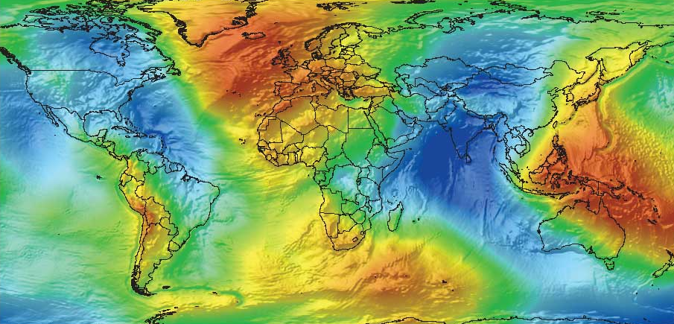
GEOID HEIGHTS
EGM96 geoid undulations wrt WGS84 ellipsoid
Image from esri.com

Slide 36
http://sps.unavco.org/geoid/
Your Input Coordinates and GPS Height: Latitude = 40° N = 40° 0' 0" N Longitude = 105° W = 105° 0' 0" W GPS ellipsoidal height = 0 (meters) Geoid height = -17.207 (meters) Orthometric height (height above mean sea level) = 17.207 (meters) (note: orthometric height = GPS ellipsoidal height - geoid height)
Note: this program uses the EGM96 geoid. The EGM96 geoid is wrt the WGS84 ellipsoid.
The EGM96 geoid is more accurate than the WGS84 geoid.

Slide 37
EAST-NORTH-UP (ENU)

Slide 38
What is ENU?
Local Topocentric Coordinate System
Up
North
East
North-East plane is perpendicular to geodetic latitude
i.e. plane that is tangential to the surface of the Earth at that point

Slide 39
Rotation from ECEF to ENU (approximate)
First R₃(λ+90^{ο}) then R₁(90^{ο} – φ)

Slide 40
Or

Slide 41
Do I need to know this? Why?

Slide 42
How will I use it?

Slide 44
VISIBILITY (AZIMUTH-ELEVATION)

Slide 45
AZIMUTH AND ELEVATION
Satellite
Up
North
East
Observer
Azimuth (az): angular measure clockwise from North direction to the horizon pierce point
Elevation (el): angular measure from horizon to line-of-sight (LOS) to the object

Slide 46
VISIBILITY
Satellite position vector in ECEF
User position vector in ECEF
LOS is a unit vector pointing
from the user location to the satellite
How do you decide if a satellite is visible?
Compute elevation and azimuth

Slide 48
SKY PLOT
How we plot them…
North
Up
East

Slide 49
GPS SATELLITES AS SEEN FROM BOULDER
24 hours

